Slide 1
CMPE223 [ISYE223] ALGORITHMS AND PROGRAMMING Autumn 2024 – 2025
Lecture 4
Sorting Methods

Slide 2
Popular Sorting Algorithms
Bubble sort
and
Selection sort
Notes:
https://algorithm-visualizer.org/

Slide 3
Bubble Sort
Bubble sort, also known as exchange sort, is a simple sorting algorithm.
It repeatedly steps through the list, compares adjacent elements, and swaps them if they are in the wrong order.
This process continues until the list is sorted.
Each pass through the list places the next largest (or smallest, depending on sorting order: ascending or descending) element in its correct position, gradually "bubbling" the largest unsorted elements to the end of the list.

Slide 4
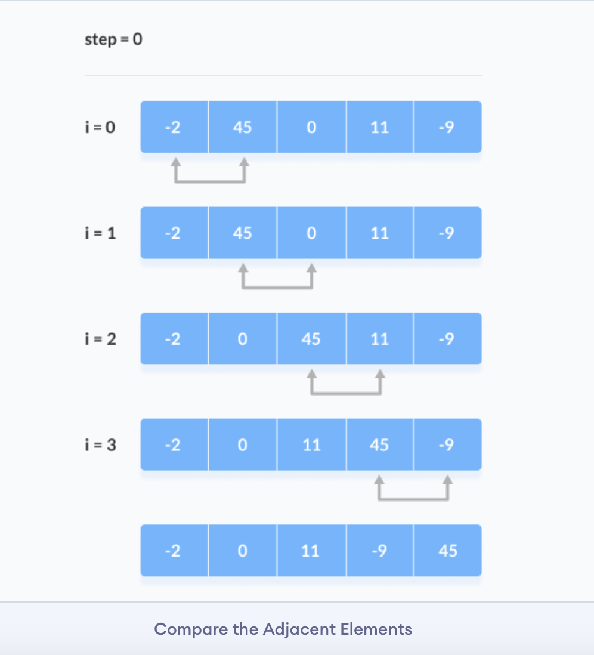
How Bubble Sort Works:
Start from the beginning of the array.
Compare the first two adjacent elements. If the first element is greater than the second, swap them.
Move to the next pair of adjacent elements and repeat the comparison and swap if necessary.
Continue this process to the end of the array; this completes one pass.
After each pass, the largest element in the unsorted portion of the array will have moved to its correct position at the end.
Repeat the above steps, ignoring the last sorted elements, until no swaps are needed in a complete pass (indicating that the array is sorted).

Slide 5
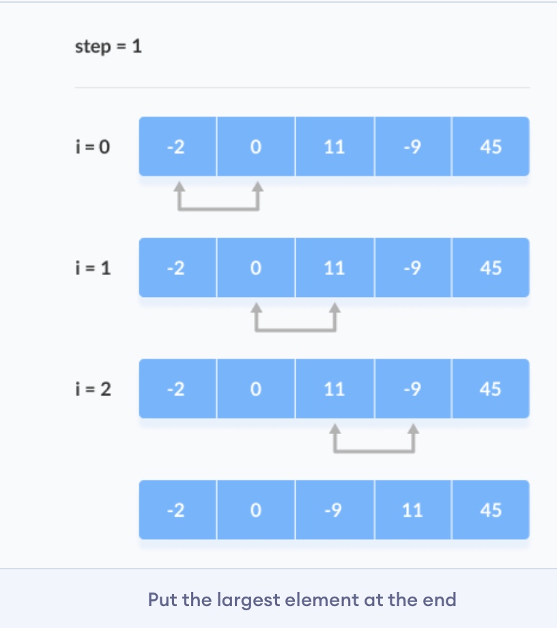
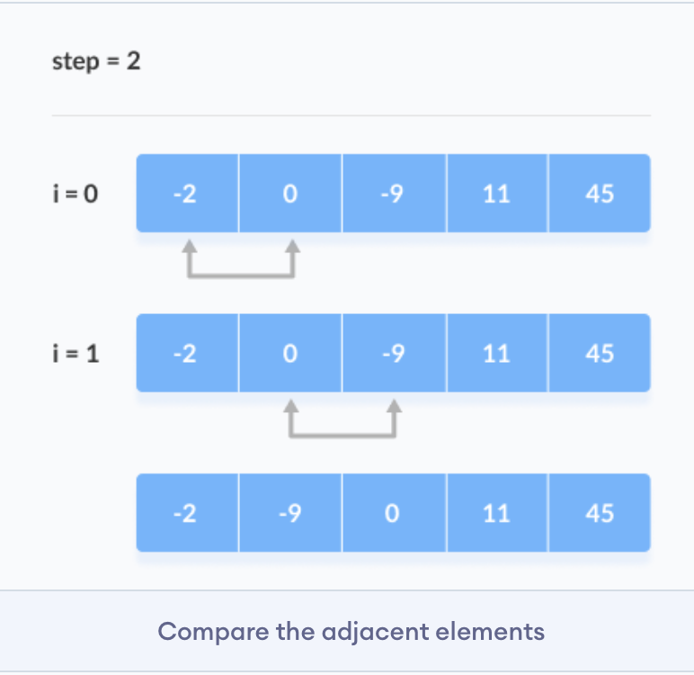
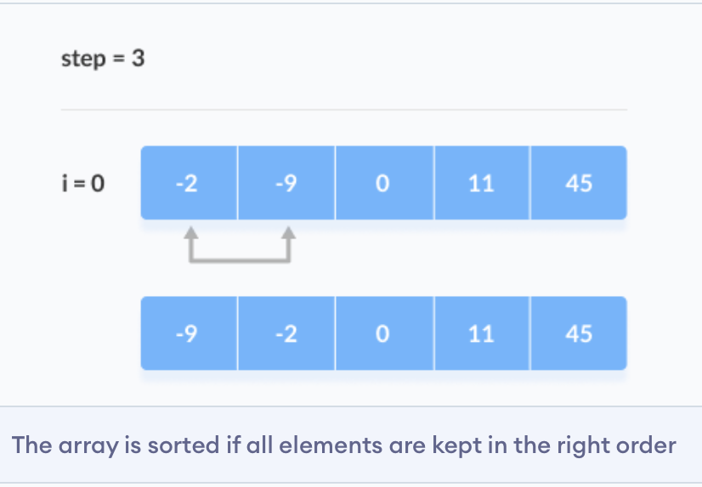
Remaining Iteration
The same process goes on for the remaining iterations.
After each iteration, the largest element among the unsorted elements is placed at the end.

Slide 6
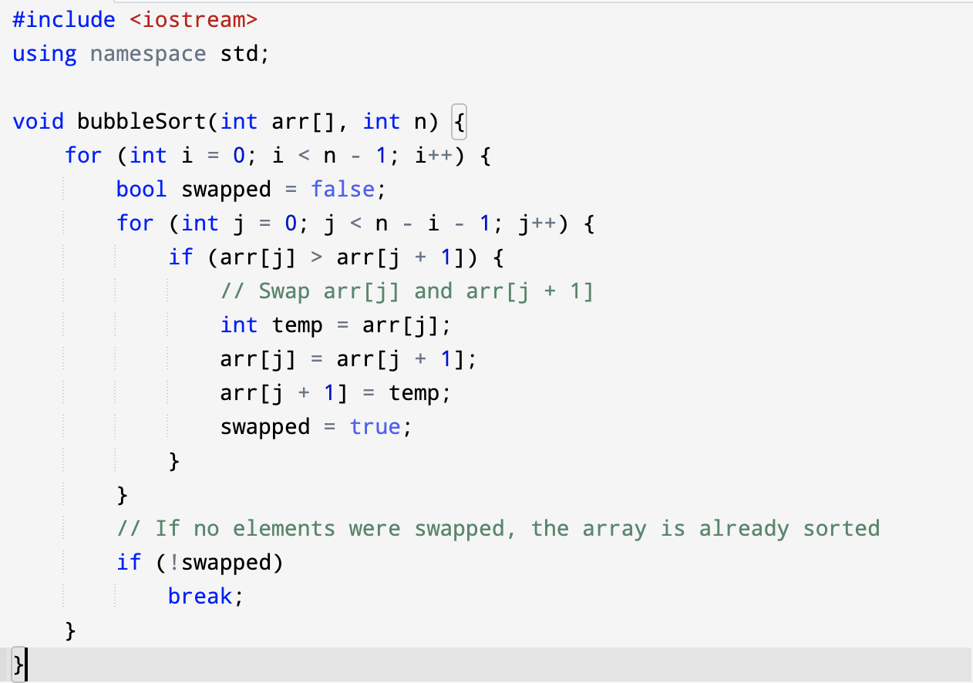
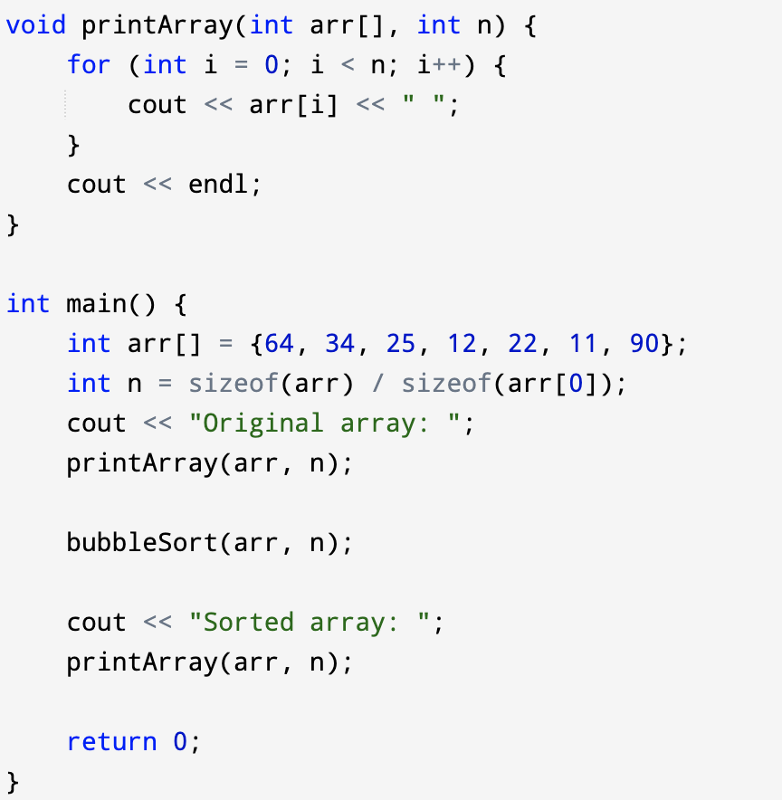

Slide 7
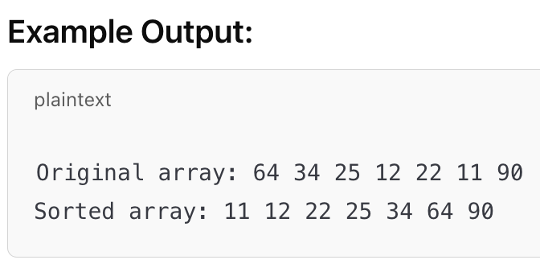
Explanation:
bubbleSort Function: It takes an array and its size as arguments. The outer loop controls the number of passes, while the inner loop performs the comparisons and swaps.
Optimization with swapped Flag: If no swaps are performed during a pass, the swapped flag remains false, and the loop breaks early, saving unnecessary passes.
printArray Function: This helper function prints the array before and after sorting for verification.

Slide 8
Selection Sort
Selection sort is a simple comparison-based sorting algorithm as an in-place comparison sort.
Selection Sort sorts an array by repeatedly finding the minimum element from the unsorted part and putting it at the beginning.
It is inefficient on large lists, and generally performs worse than the similar insertion sort.
Also has performance advantages over more complicated algorithms in certain situations.

Slide 9
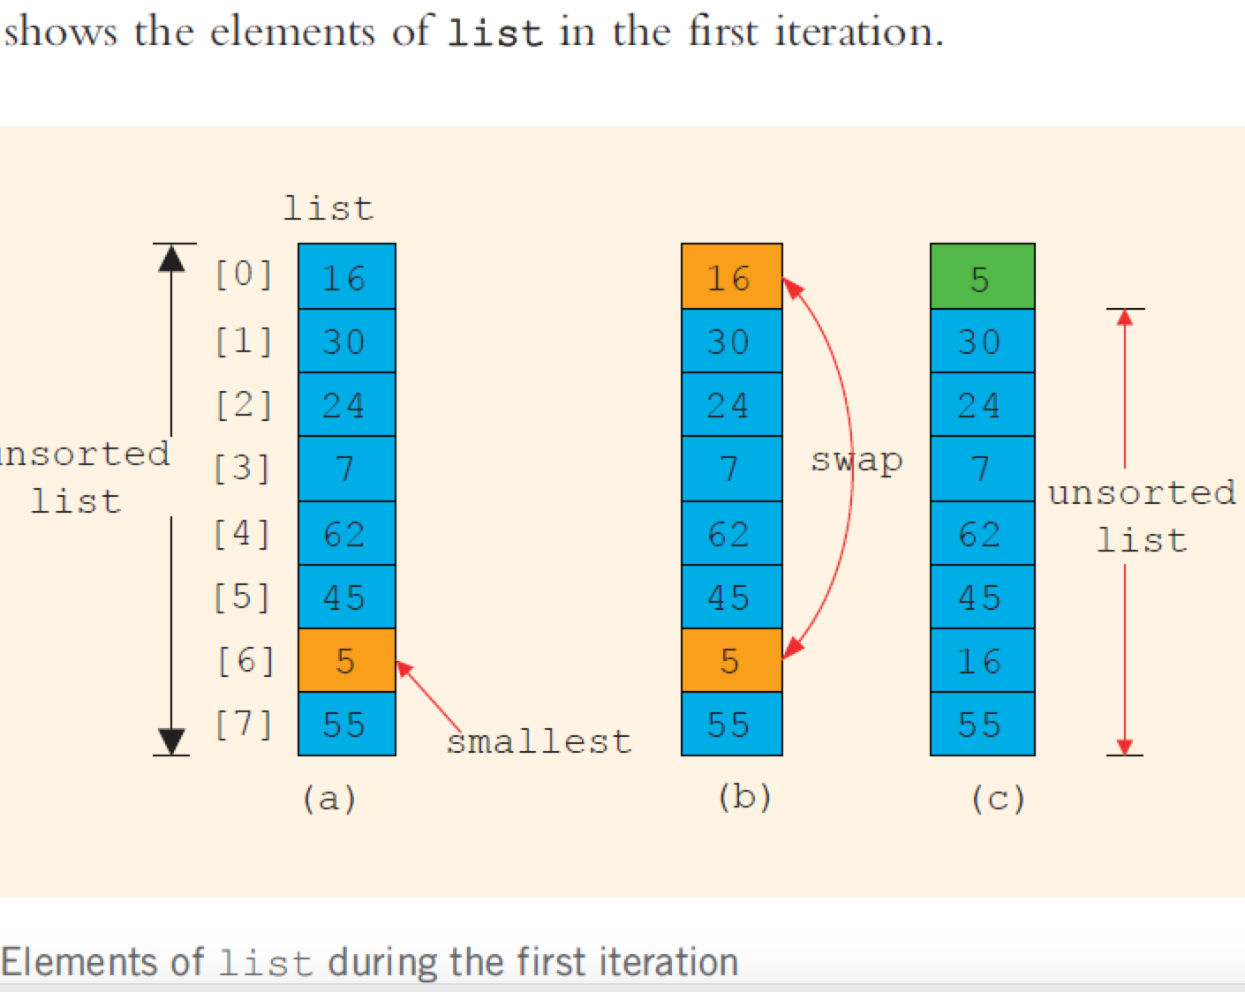
How Selection Sort Works:
Divide the array into two parts: a sorted part (initially empty) and an unsorted part (the entire array initially).
Find the smallest (or largest, depending on sort order) element in the unsorted part. (a)
Swap that element with the first element of the unsorted part. (b)
Move the boundary of the sorted part one element to the right. (c)
Repeat the above steps until the entire array is sorted.

Slide 10
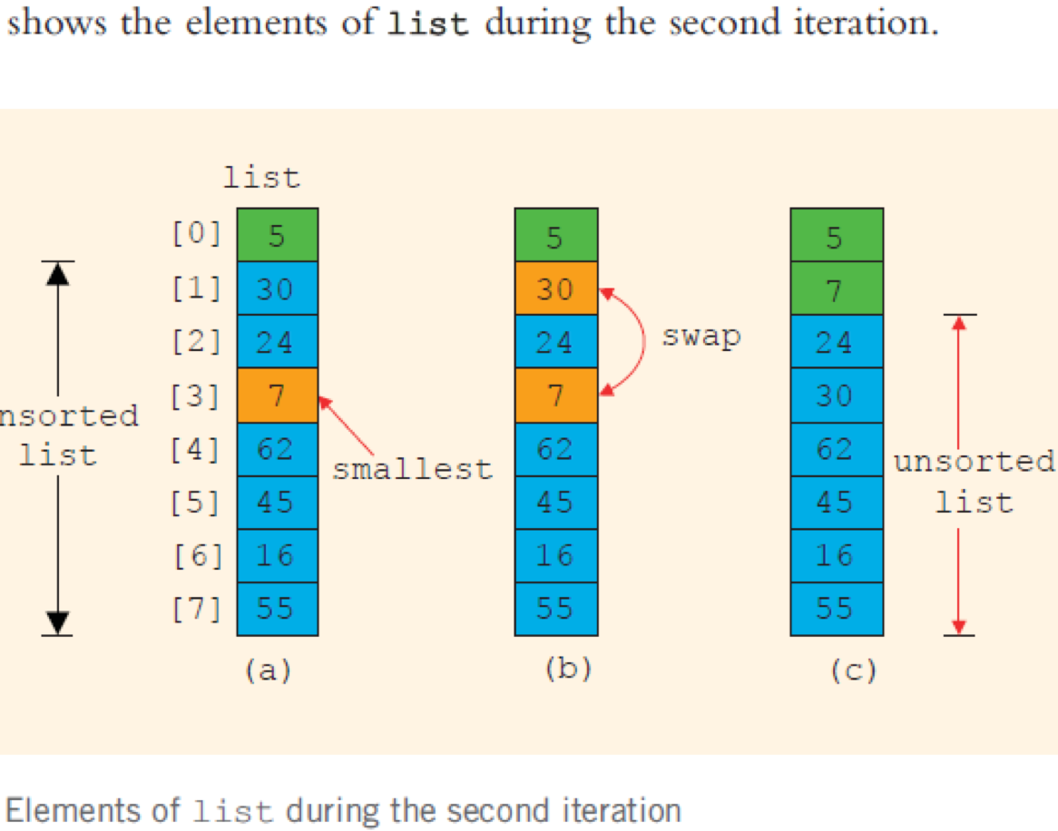
Remaining Iteration
The same process goes on for the remaining iterations.
After each iteration, the largest element among the unsorted elements is placed at the end.

Slide 11
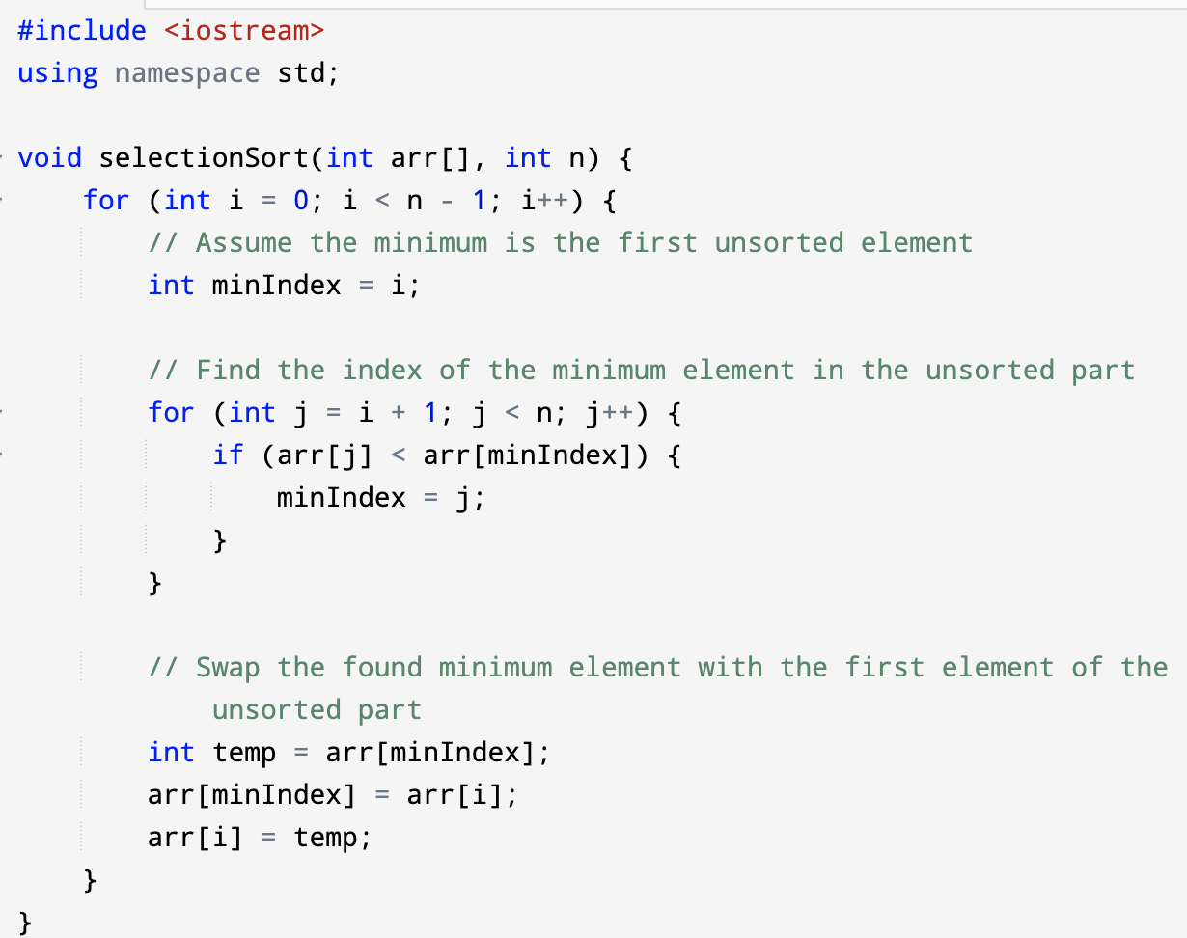
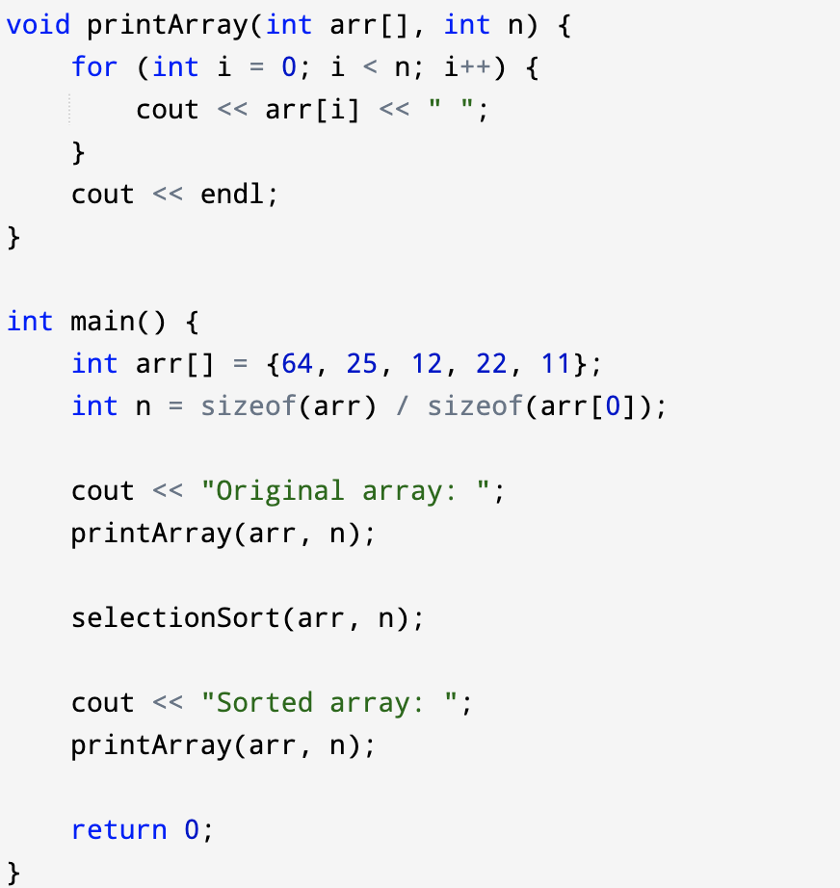

Slide 12
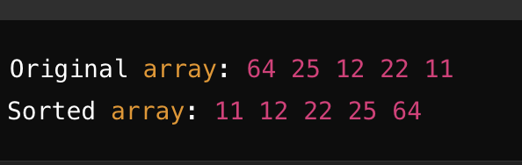
Explanation:
selectionSort Function: The function iterates through the array with a loop (for loop with index i). For each index i, it assumes the current position i is the minimum. Then, it checks all elements to the right to find the actual minimum.
Swapping: Once it finds the minimum element in the unsorted part, it swaps this minimum element with the element at index i.
printArray Function: This helper function simply prints the contents of the array.
main Function: The main function initializes the array, calls selectionSort to sort it, and then prints the sorted array.
Example Output:

Slide 13
ADDITIONAL SLIDES

Slide 14
Algorithm and Flowchart for the Bubble Sort

Slide 15
Algorithm and Flowchart for Swap Module

Slide 16
Example C Code for Bubble Sort and swap
for( i=1; i<SIZE; i++ ) // i indicates the pass number
{
for( j=0; j<SIZE-i; j++) /* j will indicate the position of the
value being compared to its neighbour */
{
if( list[j] > list[j+1] ){ // a swap must be made
temp = list[j+1];
list[j+1] = list[j];
list[j] = temp;
}
}
}

Slide 17
Selection Sort
Selection sort is a sorting algorithm, specifically an in-place comparison sort.
It is inefficient on large lists, and generally performs worse than the similar insertion sort.
Also has performance advantages over more complicated algorithms in certain situations.
It works as follows:
1. Find the minimum value in the list
2. Swap it with the value in the first position
3. Repeat the steps above for remainder of the list (starting at the second position)

Slide 18
Selection Sort
Here is an example of this sort algorithm sorting a total of five elements:
1. 31 25 12 22 11
2. 11 25 12 22 31
3. 11 12 25 22 31
4. 11 12 22 25 31

Slide 19
Algorithm and Flowchart for Selection Sort

Slide 20
Example C Code for Selection Sort with swap module
void selectionSort( int a[], int size )
{
int i, j, min;
for (i=0; i < size-1; i++)
{
min = i;
for (j=i+1; j < size; j++)
if (a[j] < a[min])
min = j;
swap(a[i], a[min]);
}
}

